Slide 1
How to use
Stepwise calibration of plenoptic cameras based on corner features of raw images
Qingsong Liu, Xiaofang Xie, Xuanzhe Zhang, Yu Tian, Jun Li, Yan Wang, Xiaojun Xu
Naval Aeronautical University
State Key Laboratory of Pulsed Power Laser Technology, College of Advanced Interdisciplinary Studies, NUDT
Applied Optics, Accepted

Slide 2
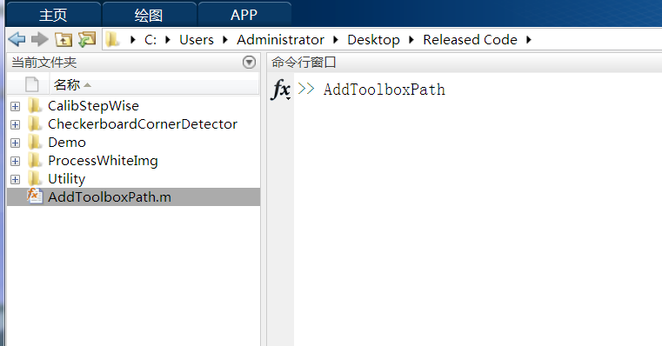
1.Installtion
Run AddToolBoxPath.m
to add the toolbox path.

Slide 3
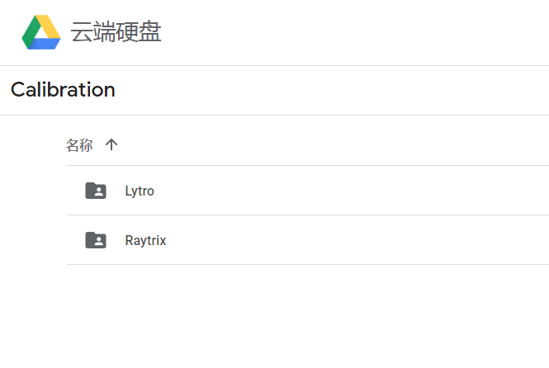
2.Download the dataset
https://drive.google.com/drive/folders/1U678kZZdN_Ei58OdWRWbedGTdQlS9GAh?usp=sharing
put the dataset anywhere on your computer without changing the name of the folders.

Slide 4
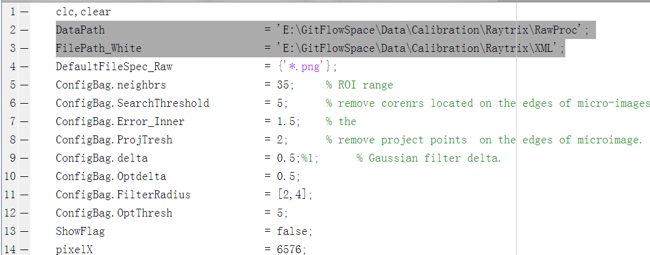
3.Change the dir
The examples are given in the “Demo” folder.
Before running the codes. You should change the data path to the actual path on your PC.
The change of data path should be done in
RunDetectDemoRaytrix.m
RunCalibDemoRaytrix.m
RunDetectDemoLytro.m
RunCalibDemoLytro.m

Slide 5
Running Order
Raytrix
1.Run RunDetectDemoRaytrix.m
2.Run RunCalibDemoRaytrix.m
Lytro
1.Run RunDetectDemoLytro.m
2.Run RunCalibDemoLytro.m

Slide 6
Question
Please contact Ph.D Qingsong Liu
E-mail : liuqingsong17@nudt.edu.cn

